Slide 1

Exploratory Data Analysis
G2M insight for Cab Investment firm
21/02/2024

Slide 2

Agenda
Executive Summary
Approach
EDA
EDA Summary
Recommendations

Slide 3
Summary – G2M strategy for cab investment
Here are the steps involved in the G2M method:
1. Data Understanding & Preparation:
Gather and organize relevant data about the cab sector, considering factors such as market size, customer demographics, and competitor analysis. Ensure the data is accurate and comprehensive.
2. Exploratory Data Analysis (EDA):
Conduct an in-depth exploratory data analysis to uncover patterns, trends, and insights within the dataset. Identify key variables that may impact market dynamics, and assess any correlations or dependencies.
3. Profit & Demand Analysis:
Analyze the profitability and demand trends in the cab sector. Examine factors influencing profit margins, such as pricing strategies and cost structures. Understand the demand patterns, considering factors like seasonal variations or economic conditions.
4. Recommendations:
Based on the insights gained from data analysis, formulate recommendations for the investment strategy. Consider aspects like potential market niches, customer preferences, and opportunities for innovation. Evaluate how short-term strategies align with long-term sustainability.

Slide 4
Data Understanding & Preparation
Time period of dataset - 31/01/2016 to 31/12/2018
Final dataset retrieved by merging of 4 interconnected datasets.
Final dataset includes 35k rows and 14 features
Data pre-processing steps undertaken:
Merged the interconnected datasets to get the final raw dataset.
Checked for null and duplicate values
Year is extracted from date column for easiness.
All the object data type is made to category type.

Slide 5
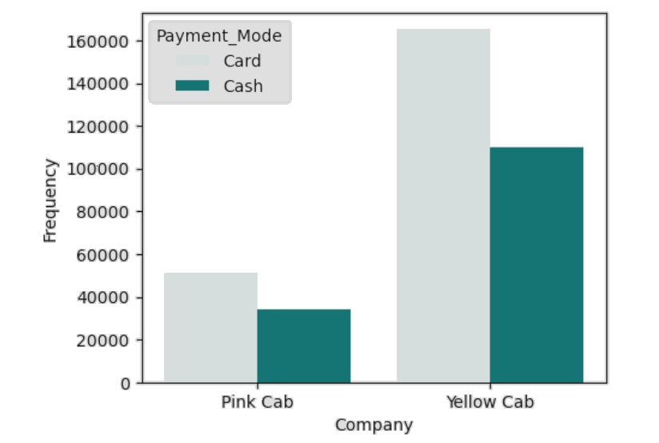
Company and Payment mode Analysis
Customer preferences may be reflected in the choice between card and cash transactions.
The higher rate of card transactions for the yellow cab suggests a technological advancement in their payment methods.
This indicates that the yellow cab caters to a diverse range of customers with differing payment preferences.
It is possible that Yellow cab has invested in efficient systems enabling smooth processing for both card and cash transactions.

Slide 6
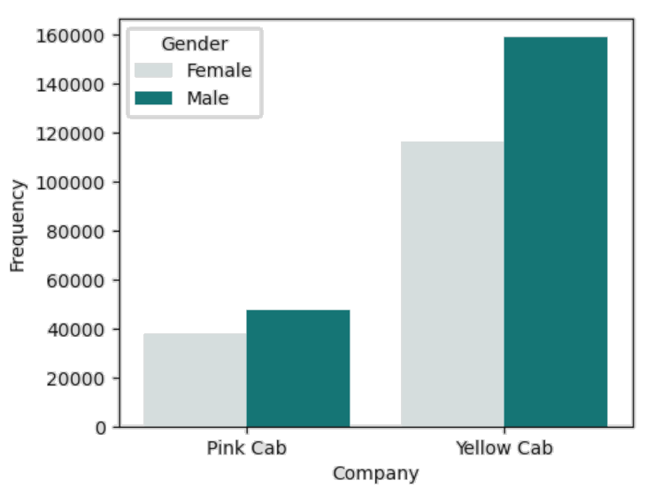
Company and Gender Analysis
The graph illustrates that the customer base for the yellow cab exceeds that of the pink cab.
Establishing a brand that is inclusive and resonates with a diverse audience has the potential to boost market appeal.
The increased number of male consumers may be attributed to the larger male population base.
The marketing and branding strategies employed by both companies might inadvertently focus or connect more with male consumers.

Slide 7
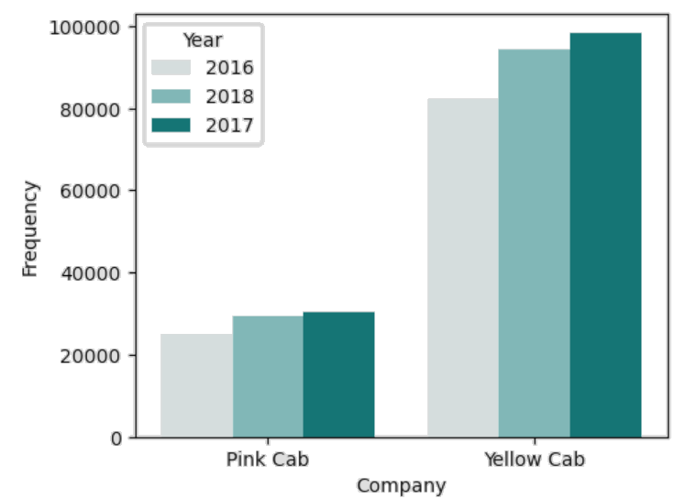
Yearly Cab Users Analysis
The rise in cab utilization between 2016 and 2017 indicates a prospective expansion in the market.
According to the graph, the customer base of the yellow cab is at least three times larger than that of the pink cab.
The heightened usage in 2017 could be linked to enhanced customer satisfaction and loyalty, possibly stemming from improved service quality or more positive user experiences.

Slide 8
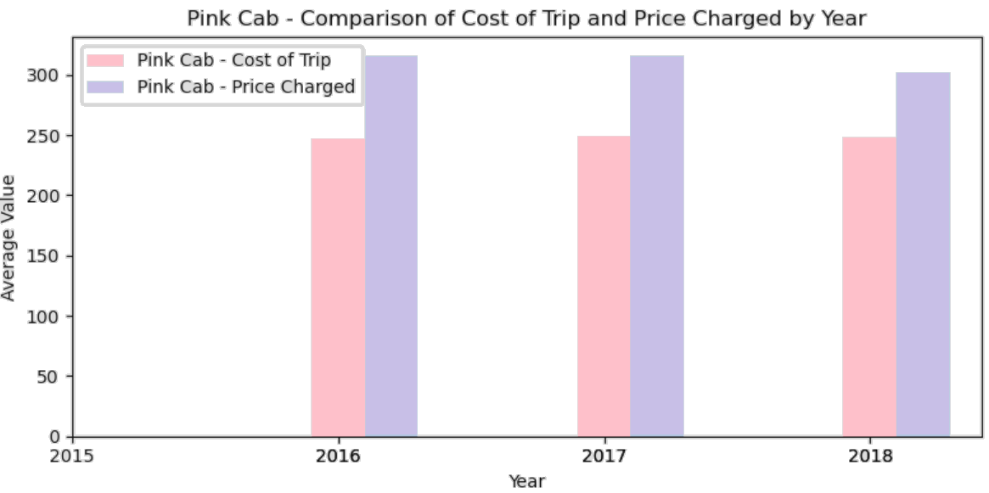
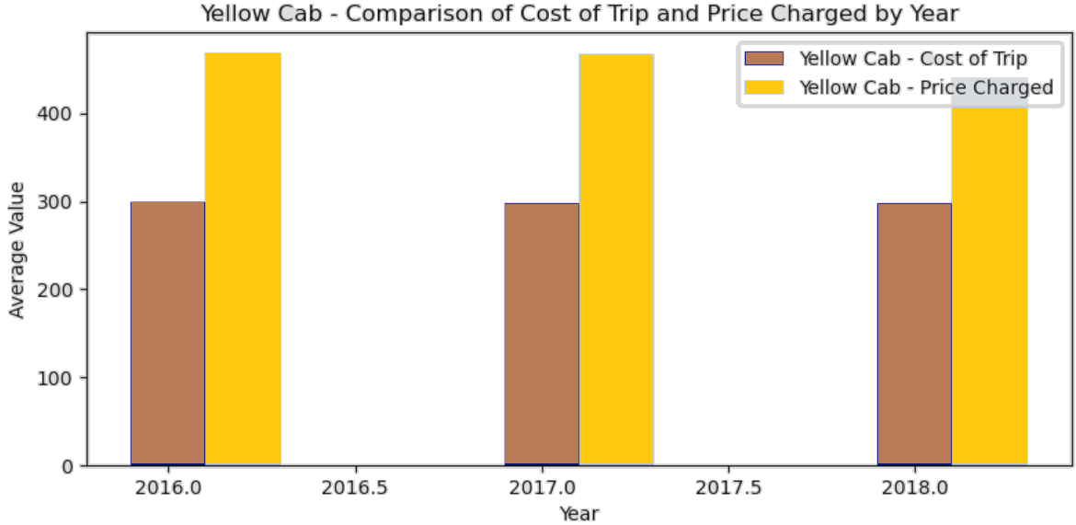
Profit Analysis

Slide 9
Recommendation
The customer reach of the yellow cab is nearly three times greater than that of the pink cab.
Yellow Cab is favored by customers due to its diverse payment options, including advanced methods, attracting a broad clientele.
Yellow Cab demonstrates a higher customer base across both genders, particularly among males, indicating its inclusive appeal.
Comparing profit analyses, the average profit for Yellow Cab is three times greater than that of its counterparts.
Based on the aforementioned analysis and insights, our recommendation for investment leans towards the yellow cab.

Slide 10
Thank You

